Slide 1








Slide 2
Mobiles in Flipkart
The Problem Statement is to find the factors which determine the mobile price (of the mobiles sold in flipkart)

Slide 3
About Me
Background: B-Tech in Biotechnology and Biochemical Engineering.
I want to learn Data Science to help my career, in my Biotechnology Projects, and further things which greatly depend on Data Science.
No previous work experience.
As far as now, the teaching was at my pace. So I was able to grasp the concepts.

Slide 4
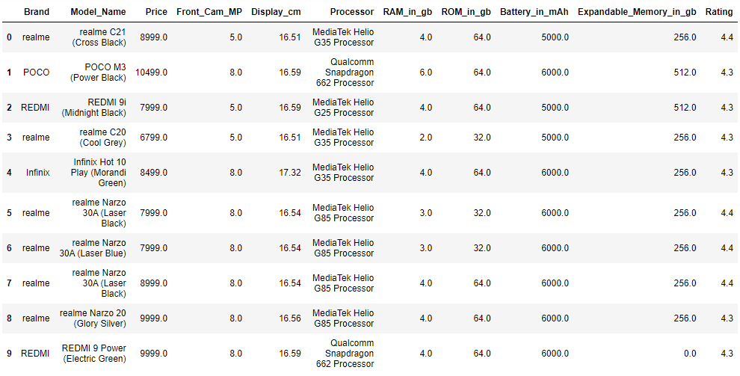
Dataset

Slide 5
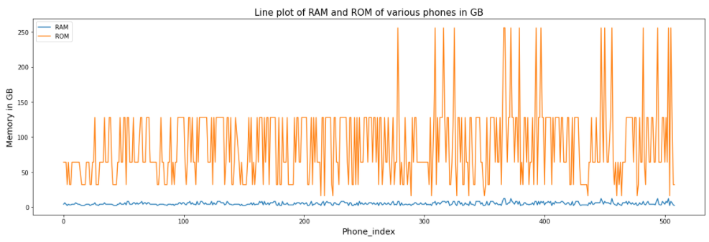
Line plots of RAM and ROM of various phones in GB
The mean value of ROM is quite high as compared to mean RAM value. RAM median is 4 GB while ROM median is 64GB.
There are around 16 phones which have a ROM of 256, while all the other phones are between 16 and 128.
RAM values are between 2 and 12. Since the value of RAM is low (as compared to ROM), we can see that it has less variance.

Slide 6
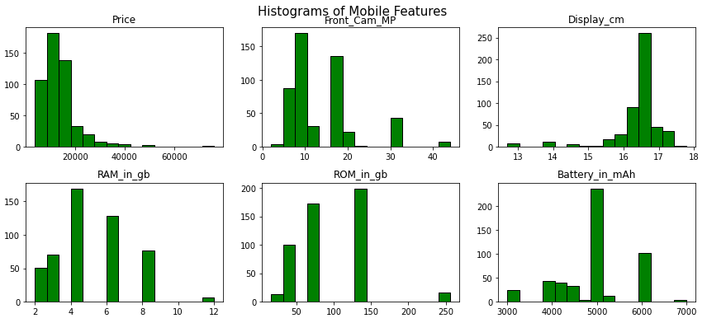
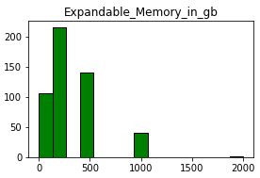
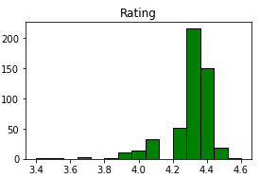
UNIVARIATE PLOTS OF MOBILE FEATURES: Histograms of the mobile features
We can try to remove the skewness of the graphs by applying logarithm.
Left Skewed: Rating, Battery, Display.
Right Skewed: Front Cam, Price, Expandable Memory, ROM.
RAM has a normal distribution.

Slide 7
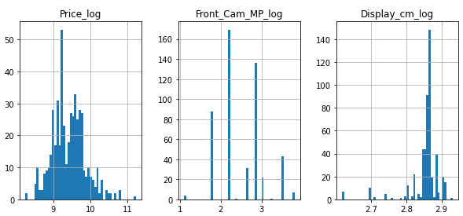
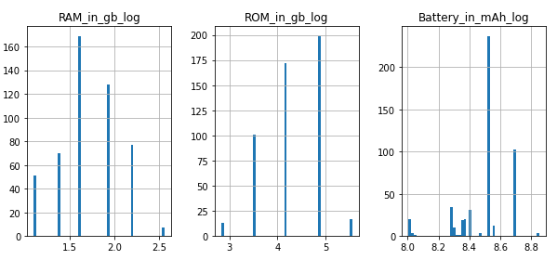
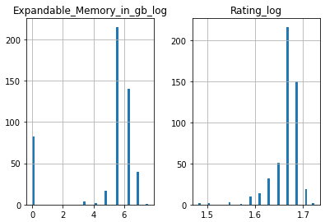
Log Log Plot of Mobile Features
The attempt to reduce skewness of the above graphs has failed, as even after applying logarithm, they are still skewed.

Slide 8
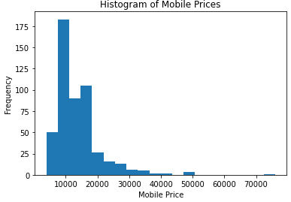
Histogram of Mobile Prices
The graph is a histogram of the mobile prices(Rs).
The graph is right skewed, and there is a high frequency of the mobiles in the range: 5000 to 18000.
Highest Frequency of mobiles is at around 10000 and the lowest is near 40000.
We have very less number of mobiles greater than 30000.

Slide 9
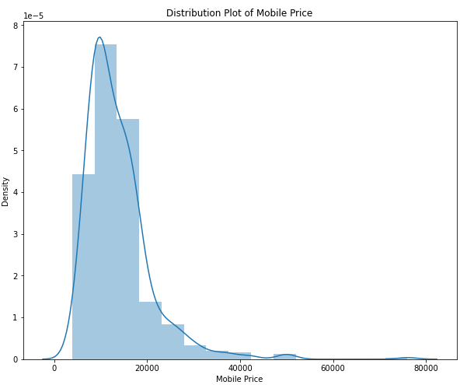
Distribution Plot of Mobile Price
The distribution plot gives how the mobiles are distributed at different prices.

Slide 10
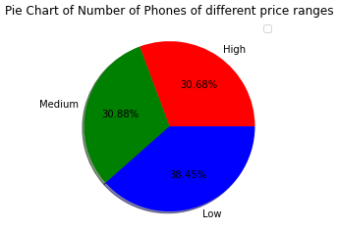
Pie Chart of Number of Phones of different price ranges
This gives the percentage of the phones which have high, low, medium prices in a pie chart.
The order of the proportion of the phones is Low price phones> Medium price phones> High price phones.

Slide 11
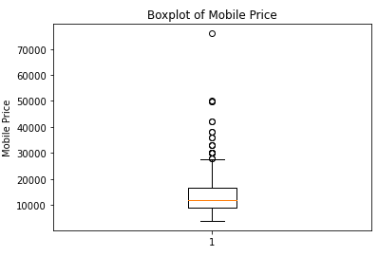
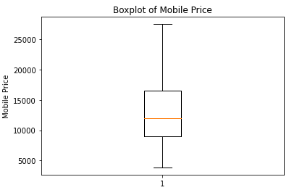
Box plots of Mobile Price
The mobile prices(excluding the outliers) are between with the median at around 11500.
There are outliers (i.e data points above the inter quartile range) which has a price of more than 27000.
The range of prices between the first 50% of the mobiles is less than that of the last 50%.

Slide 12
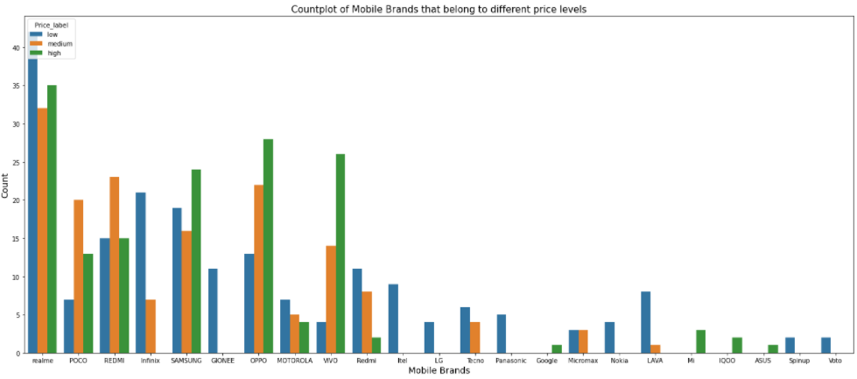
Count plot of Mobile Brands that belong to different price levels
Most phones belong to realme, REDMi, Infinix, SAMSUNG, OPPO, VIVO, POCO.
The count plot of the number of phones of a particular brand which belong to a particular price label(high, medium, low).
realme has the highest number of phones above 15,000Rs.It is followed by OPPO, VIVO.
realme has the highest number of phones between 15000Rs to 10000Rs, followed by REDMi, OPPO, POCO.
realme has the highest number of phones below 10000Rs, followed by Infinix, SAMSUNG.

Slide 13
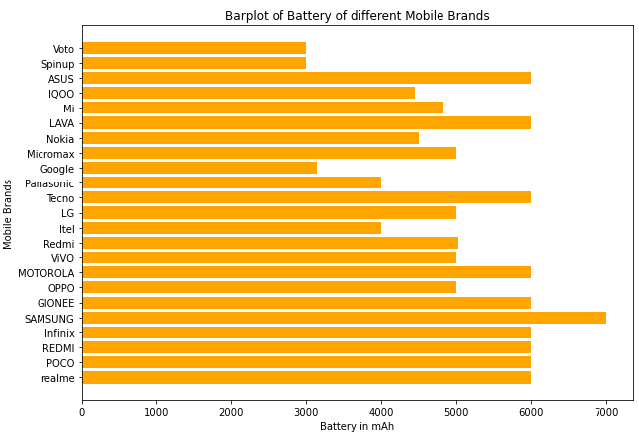
Bar plot of Battery of different Mobile Brands
It gives the battery levels of different mobile brands, in a bar plot.
The highest battery life is 7000mAh, offered by SAMSUNG, followed by 6000mAh by many Brands like: REDMI, realme, GIONEE etc
The least battery life is 3000mAh, offered by Voto, Spinup.

Slide 14
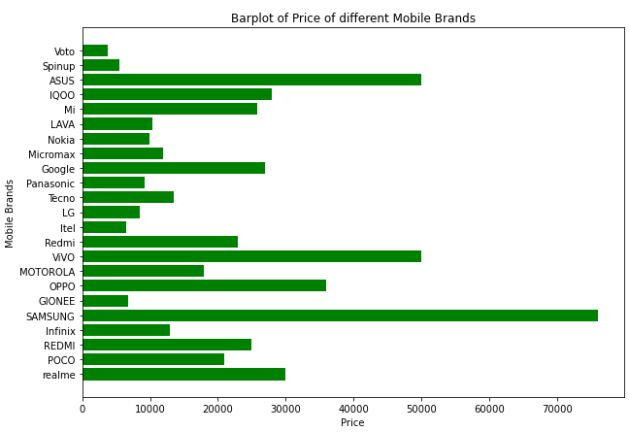
Bar plot of Price of different Mobile Brands
It gives the Price of different mobile brands, in a bar plot.
The costliest brands are SAMSUNG(76000) followed by ASUS,VIVO.
Most of the brands are between 5000 and 30000.
The cheapest phones are Voto, Spinup, Itel, GIONEE, as they are not so popular.

Slide 15
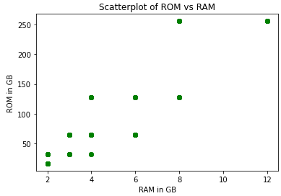
Scatter plot of ROM vs. RAM
We can see that there is a positive correlation between RAM and ROM. That is, the increase in one, also increases the other.
Most of the phones are having a RAM(2-8 GB).
Most of the phones are having a ROM(10-150 GB).

Slide 16
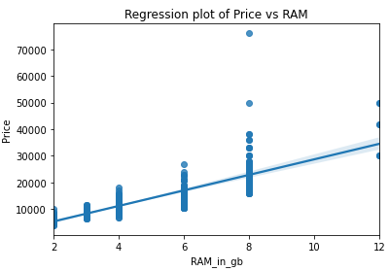
Regression plot of Price vs. RAM
Phones that have higher RAM are having a higher price.
But we can see that the mobiles with a RAM of 4,6,8 GB are having a range of prices.
This indicates that there are other factors which affect the price, other than the RAM.

Slide 17
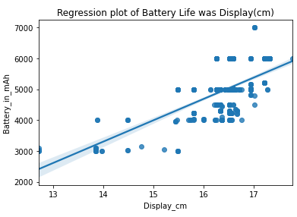
Regression plot of Battery Life vs. Display(cm)
It appears that Display and Battery are positively correlated.
Most of the phones are between Display(15.5-17.5cm) and Battery(4000-6000 mAh).

Slide 18
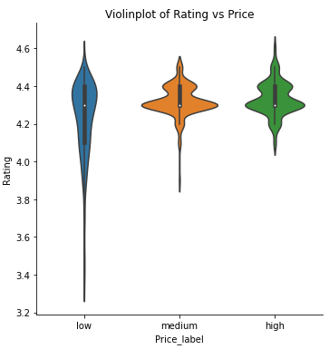
Violin plot of Rating vs. Price
Almost all the price labels have similar median rating( the white dot in the middle of the black box).
The black box represents the inter-quartile range.
Most phones (of the three price labels) are given a rating between 4.25 and 4.45.
Especially the high price and medium price phones are mostly given a rating between 4.2 and 4.35.
The bulging of the violin, indicates that most of the data points are at that position.
This proves that the rating is not so much influenced by price.

Slide 19
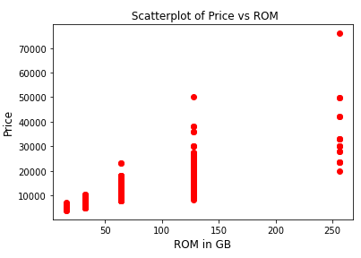
Scatter plot of Price vs. ROM
There is an increase in price with the increase in ROM.
There are a range of prices for a particular ROM, which proves that there are other factors which influence the price.
ROM values are: 32,64,128,256 GB.
Most of the phones are having a ROM of 128 GB. There is a range of prices of phones of 128 GB RAM.

Slide 20
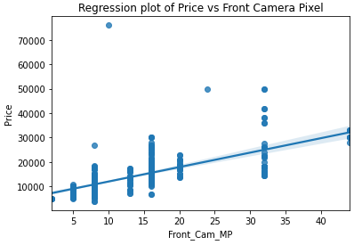
Regression plot of Price vs. Front Camera Pixel
It appears that Price and Front Camera Pixel are positively correlated.
But we can see a range of prices for a particular Front Camera Pixels.
This indicates that there are other factors which influence the Price.
The costliest phone is having a Front Camera Pixel of 10 MP.
Most phones are having a Front Camera Pixel between 5 to 32 MP.

Slide 21
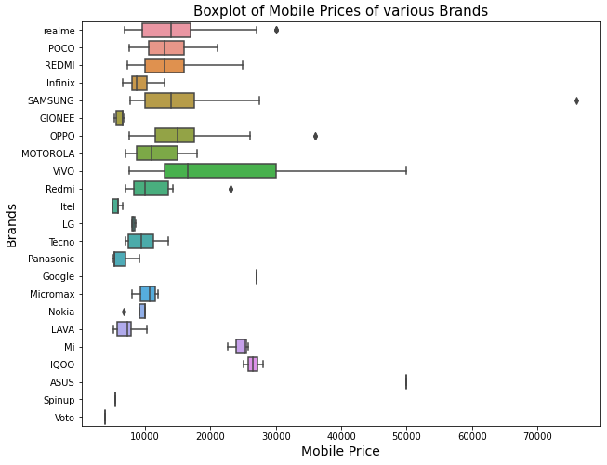
Box plot of Mobile Prices of various Brands
This gives the range of prices of mobiles of a brand.
The Brands which have only a single line, either should have a constant price for all of its phones, or there must be only one phone in the acquired dataset.
The brand : IQOO has the highest price range. All its phones are between 25000 to 30000. IQOO has 100% of its mobiles in this range.
But there are other brands like VIVO, SAMSUNG and realme which have a part of their mobiles between 25000 and 30000.
There are brands who appear only once in the list, that have prices more than 25000, like ASUS, Google etc
Most of the brands are having a price range between 5000 to 25000.

Slide 22
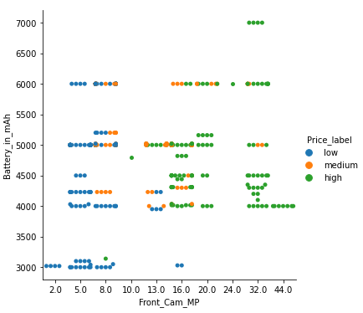
Categorical plot between Front Camera Pixel and Battery
As the Front Camera Pixel is increasing, the price is also increasing.
We can see that the mobiles with high front camera pixel(>13MP) require a higher Battery life(>4000mAh).
Similarly the lower Front Camera MP phones need less Battery life.
But we can see that some phones with moderate Front_Cam_MP(8MP) are also having a Battery life above 4000mAh.
This indicates that the Battery life is influenced by factors other than the Front Camera Pixel.

Slide 23
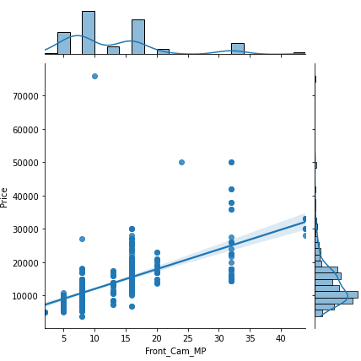
Joint plot of Price vs. Front Camera Pixel
Front_Cam_MP and Price are positively correlated. As one increases, the other one is also increasing.
Most of the phones are in the price range: 5000 to 20000.
Most phones are having a Front_Cam_MP between : 5 to 20 MP.
16MP is the Front_Cam_MP of most of the phones.

Slide 24
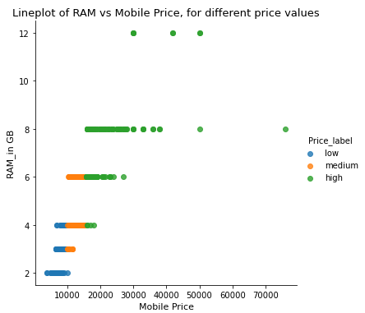
Line plot of RAM vs. Mobile Price for different price values
It gives the RAM of different mobiles and their Prices.
The data points are differentiated on the basis of their Price label (high, medium, low)
The low price phones are having a low RAM between (0-4GB),and the high price phones have a RAM equal or above 4GB.
This proves that RAM influences the price.

Slide 25
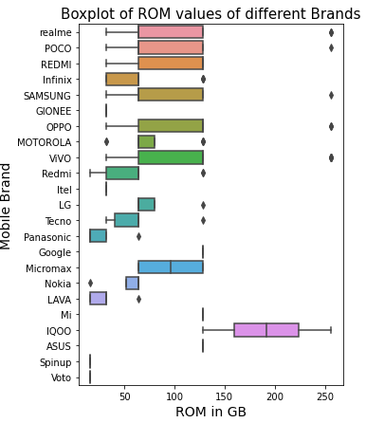
Box plot of ROM values of different Brands
It gives the range of ROM for different mobile brands.
Most of the Brands are in the range of 32 GB to 128GB ROM.
The exceptions are realme, POCO, SAMSUNG,OPPO,VIVO offering 256 ROM.
All the mobiles of IQOO offer a ROM(128-256 GB) higher than most phones.

Slide 26
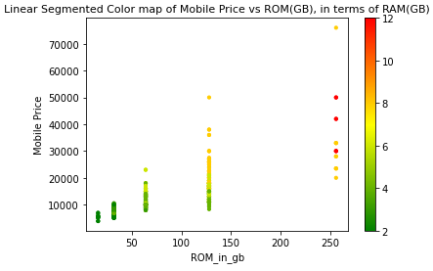
Linear Segmented Colour map of Mobile Price vs. ROM(GB), in terms of RAM(GB)
The higher RAM values are red in color, the medium ones are yellow, and the lower RAM are in green.
Low ROM phones with a low RAM are cheap in price.
As RAM and ROM are increasing we can see an increase in price

Slide 27
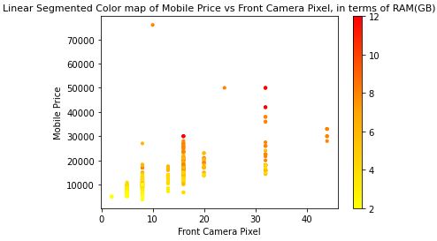
Linear Segmented Colour map of Mobile Price vs. Front Camera Pixel in terms of RAM(GB)
The higher RAM values are red in color and the lower RAM are in yellow
The phones with less front camera pixel are having less RAM. And they are of less price.
The phones with higher front camera pixel are having higher RAM. And they are more costly

Slide 28
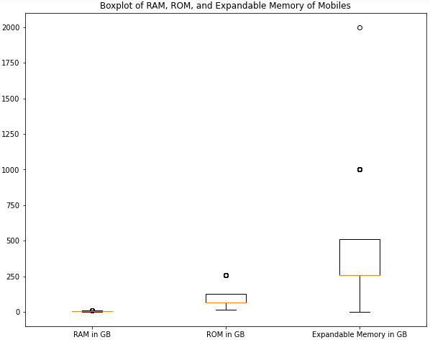
Box plot of RAM, ROM and Expandable Memory
The ROM data points are well spread across different Memory GB, while RAM is has values between 2 to 12 GB
The Expandable Memory data points are even more well spread than ROM
So the order of variance is Expandable_Memory > ROM in GB >RAM in GB
This shows that the median of ROM is around 64GB, and median of RAM is 4GB
The ROM data points are spread between 16 to 128 GB, with outliers at 256 GB

Slide 29
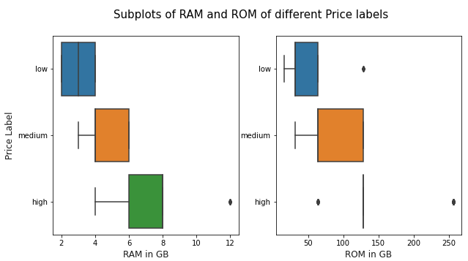
Sub plots of RAM and ROM of different Price labels
The RAM and ROM values are increasing with the increase in price.
The values of ROM of high price phones is around 125. And the spread is also very small.
For medium and high price, the median and maximum coincide for a particular RAM value.
For all price labels, the median and maximum coincide for a particular ROM value.

Slide 30
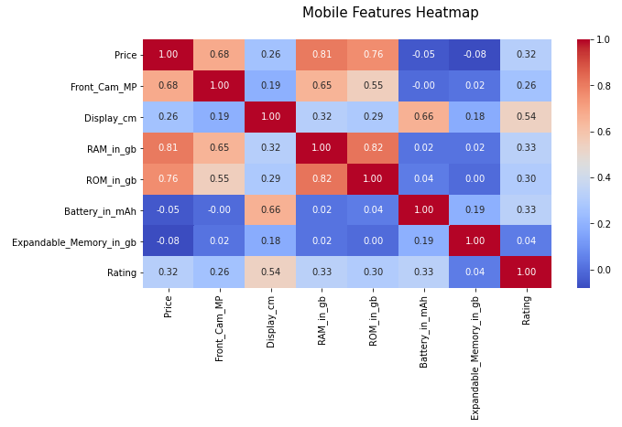
Heat map of Mobile Features
Price is depends on (or positively related to) RAM, ROM, Front Camera pixel.
Front camera pixel is positively related to RAM and ROM.
RAM and ROM are positively related to each other.
The Display is positively correlated with Battery and Rating.

Slide 31
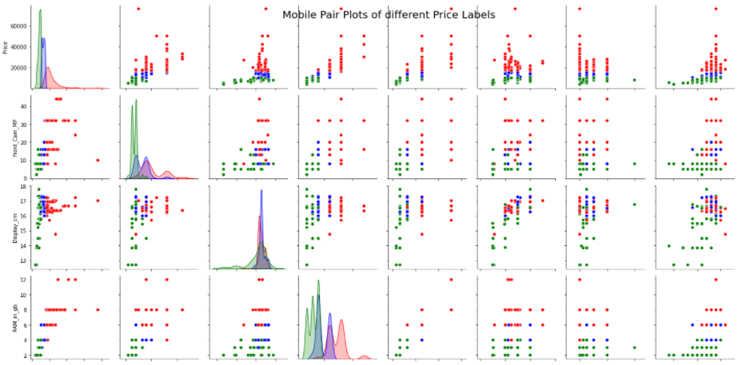
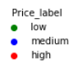
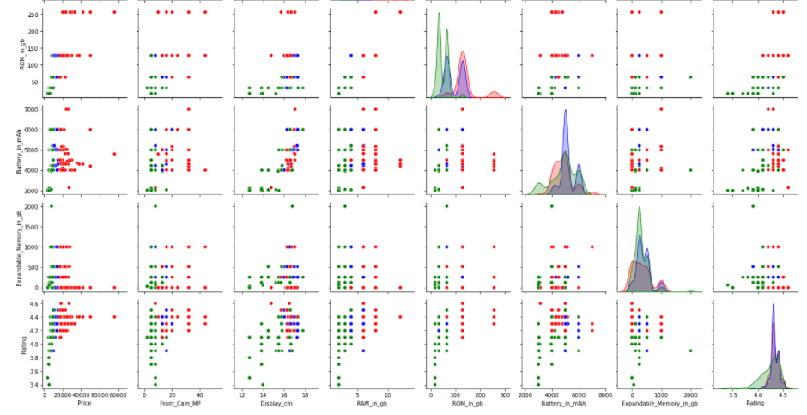
Pair plot of mobile features, based on price labels

Slide 32
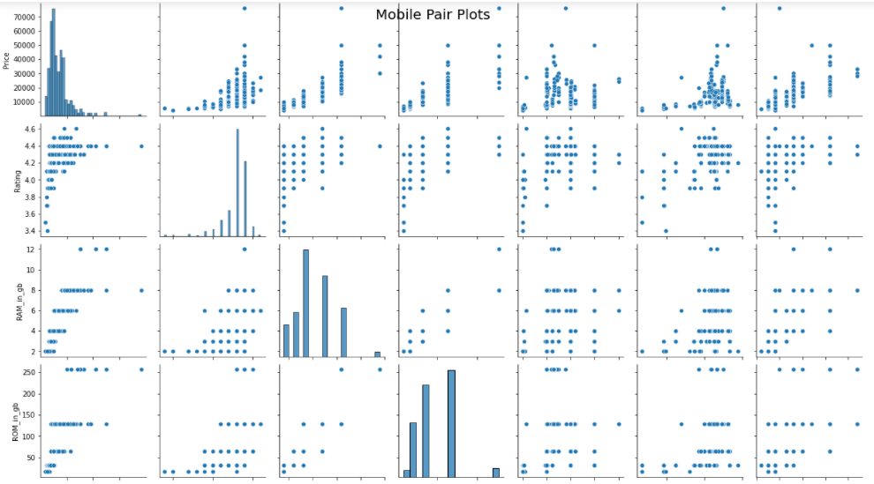
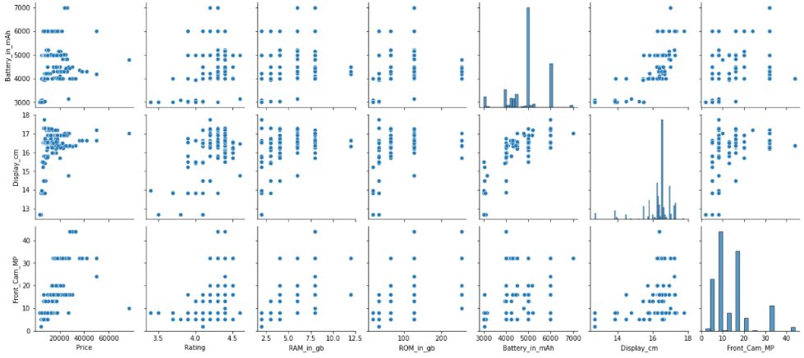
Pair plot of mobile features

Slide 33
Pair plot of Mobile Features
Pair plot of mobile features.
We can see the positive correlation of price with RAM, ROM, Front_Camera_MP.
Price, Front Cam, ROM are right skewed. Display, Battery, Rating are left skewed. And RAM is normal.
Front camera pixel is positively related to RAM and ROM.
RAM and ROM are positively related to each other.

Slide 34
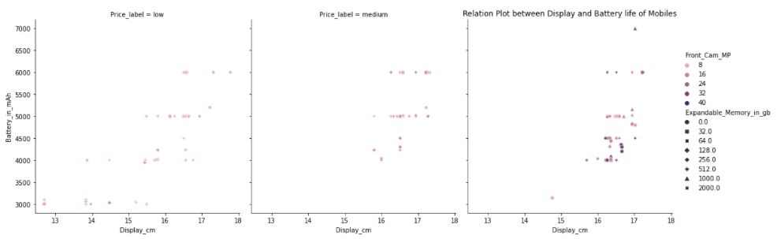
Relation plot between Display and Battery life of mobiles
Relation Plot between Battery and Display, for different price labels.
They are differentiated for different expandable memory and front camera mega pixel.
Higher the price, more is the front camera MP.
Battery and Display are positively correlated.

Slide 35
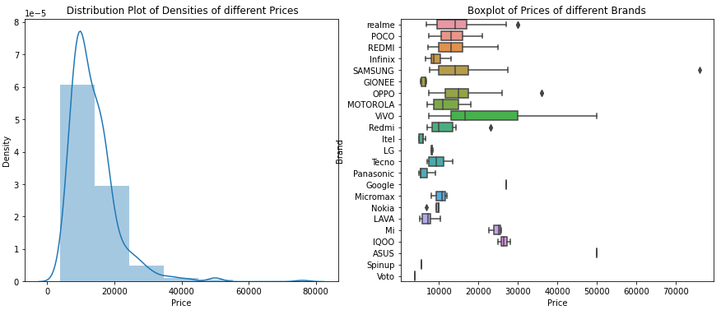
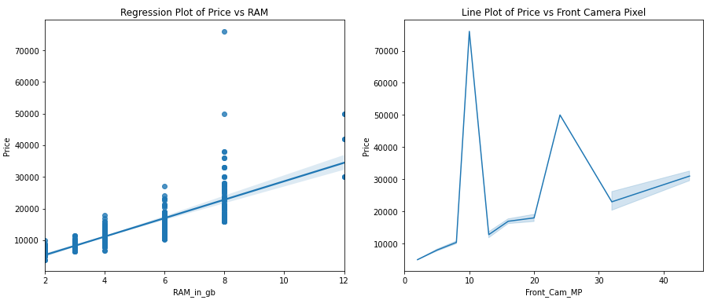
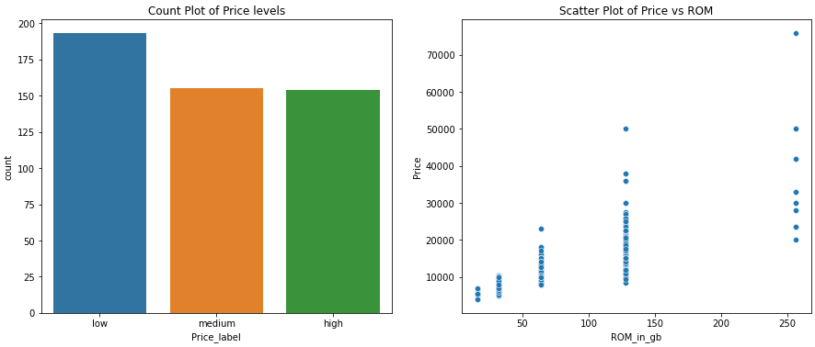
Subplots of Mobile Features and Price
Price density is highest at 8000-12000. It is a right skewed plot.
Most brands have their price ranges between 5000 and 25000.
Price and RAM are positively correlated, but Price depends also on other factors also.
Price and Front Camera Pixel are also positively correlated. There is a 75000RS phone of 10 MP.
The low price phones (<10000) have the highest count, followed by the medium (10000-15000) and then the high price phones(>15000).
Price and ROM are positively correlated. The highest price phone is having a ROM of 128 GB.

Slide 36
Future Scope and Conclusions
The factors that determine the mobile Price are RAM, ROM, front Camera Pixels.
We can see the correlation between different features of the mobile, in this analysis. (Front camera pixel is positively related to RAM and ROM; RAM and ROM are positively related to each other; The Display is positively correlated with Battery and Rating).
We can do this also for the phones which don’t have a front camera, and that would cover other mobiles of other price ranges.

Slide 37

THANK YOU

